Slide 1
iText Tutorial
12/27/2013
Ryan Huang
PMA Consultants LLC
rhuang@pmaconsultants.com

Slide 2
Overview
http://itextpdf.com/
A programmable PDF Software
Java, C#, Android
Created by Bruno Lowagie
Book: iText in Action
License
Commercial, AGPL

Slide 3
Sample codes
Download from
https://github.com/RyanHuangPMA/iTextTutorial.git
Import using “Existing Projects into Workspace”
Add JDK and iText library into project build path

Slide 4
Create first PDF
5 steps
T01_HelloWord.java

Slide 5
Chunk, Phrase, Paragraph
Paragraph: a Phrase with extra properties and a newline
T02_Paragraph.java
Phrase: a list of Chunks with leading
T03_Phrase.java
Chunk: a String, a Font, and some attributes
is the smallest significant piece of text that can be added to a Document
T04_Chunk.java

Slide 6
Image
Add Image into Document directly
T05_Image.java
Add Image into Chunk first
T06_Image.java

Slide 7
Table
PdfPTable and PdfPCell
T07_Table.java

Slide 8
Chapter & Section
Generate bookmarks automatically
T08_Chapter.java

Slide 9
Generate PDF from a servlet
use ByteArrayOutputStream first
set Content Length
write ByteArrayOutputStream to the ServletOutputStream
T09_HelloServlet.java

Slide 10
PDFReader
Access a existing PDF
T10_AccessPDF.java

Slide 11
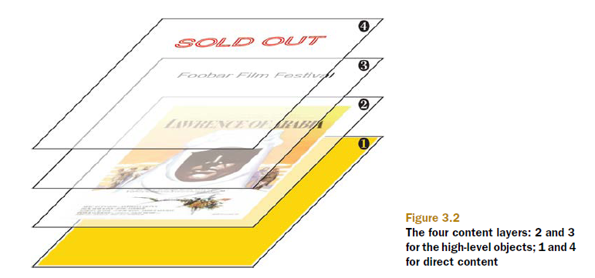
ColumnText
Allow you to write text in any position
Work with PdfContentByte
writer.getDirectContent()
writer.getDirectContentUnder()
T11_ColumnText.java

Slide 12
PdfImportedPage
Import page as image
T12_ImportPages.java
Import page as template in page event
T13_ImportStationery.java

Slide 13
Table Of Content (TOC)
Use two passes to generate final PDF
Use SimpleBookmark to retrieve outline
Write outline into ColumnText
Generate TOC from ColumnText
Change page labels
Generate final PDF
T14_TOC.java

